Slide 1

AI for Oracle Bone Script Recognition
Supervisor Ruihai Dong 董
Members
13203113 Yongzhen Ren 任
14207153 Lin Lyu 吕
14207180 Lulu Wang 王

Slide 2
CONTENTS
壹
Introduction
贰
Completed Work
What we did
How we did this
叁
Challenges
肆
Extensions
What did we confront
What we will do

Slide 3
壹
Introduction
What we did
PPT模板下载：www.1ppt.com/moban/ 行业PPT模板：www.1ppt.com/hangye/
节日PPT模板：www.1ppt.com/jieri/ PPT素材下载：www.1ppt.com/sucai/
PPT背景图片：www.1ppt.com/beijing/ PPT图表下载：www.1ppt.com/tubiao/
优秀PPT下载：www.1ppt.com/xiazai/ PPT教程： www.1ppt.com/powerpoint/
Word教程： www.1ppt.com/word/ Excel教程：www.1ppt.com/excel/
资料下载：www.1ppt.com/ziliao/ PPT课件下载：www.1ppt.com/kejian/
范文下载：www.1ppt.com/fanwen/ 试卷下载：www.1ppt.com/shiti/
教案下载：www.1ppt.com/jiaoan/ PPT论坛：www.1ppt.cn

Slide 4




Introduction
Background Overview
Oracle bone script recognition barriers
Even linguists cannot recognize them
Governments are even willing to take out 100,000 RMB for identifying a single Oracle bone script character
Deep learning explosion
Due to the advancement of hardware like GPU
Perform well in computer vision problems
商
Business
马
Horse
雨
Rain
袭
Attack

Slide 5
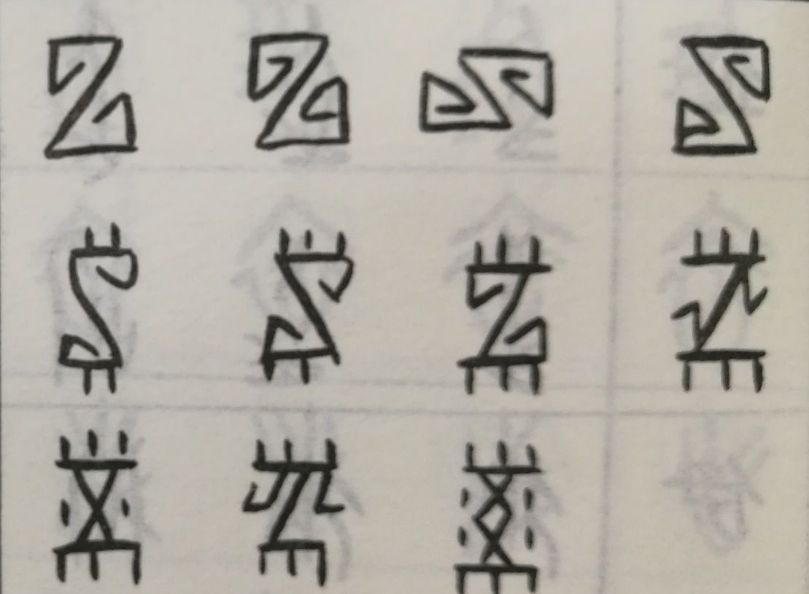
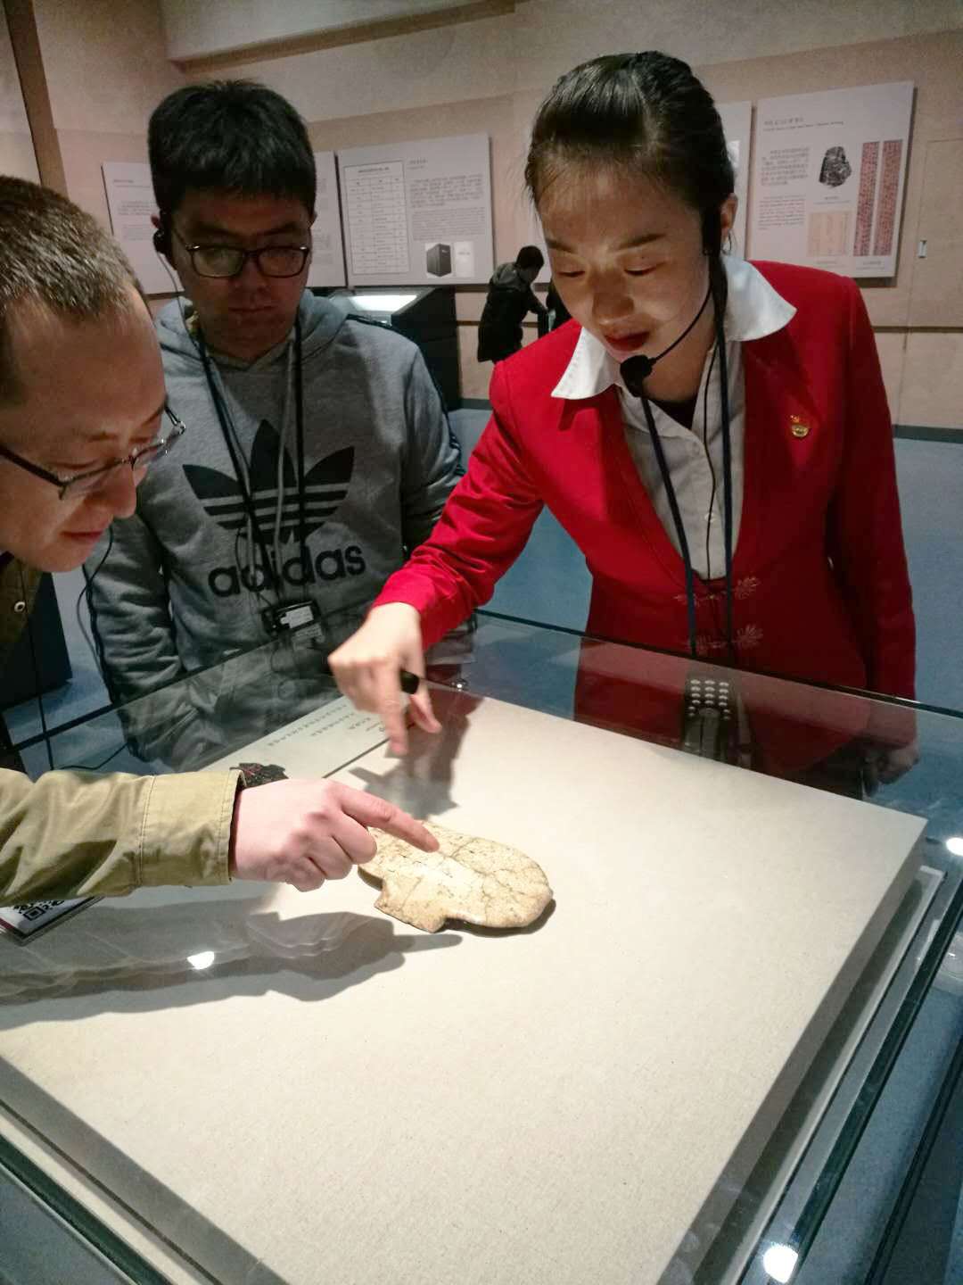
Introduction
Project Aim
Oracle bone script recognition using deep learning methods
Use classification model -- CNN
Use generative model -- GAN
Unrecognized
Oracle scripts
Visit the Chinese Character Museum in Anyang

Slide 6
贰
Completed Work
How we did this
PPT模板下载：www.1ppt.com/moban/ 行业PPT模板：www.1ppt.com/hangye/
节日PPT模板：www.1ppt.com/jieri/ PPT素材下载：www.1ppt.com/sucai/
PPT背景图片：www.1ppt.com/beijing/ PPT图表下载：www.1ppt.com/tubiao/
优秀PPT下载：www.1ppt.com/xiazai/ PPT教程： www.1ppt.com/powerpoint/
Word教程： www.1ppt.com/word/ Excel教程：www.1ppt.com/excel/
资料下载：www.1ppt.com/ziliao/ PPT课件下载：www.1ppt.com/kejian/
范文下载：www.1ppt.com/fanwen/ 试卷下载：www.1ppt.com/shiti/
教案下载：www.1ppt.com/jiaoan/ PPT论坛：www.1ppt.cn

Slide 7
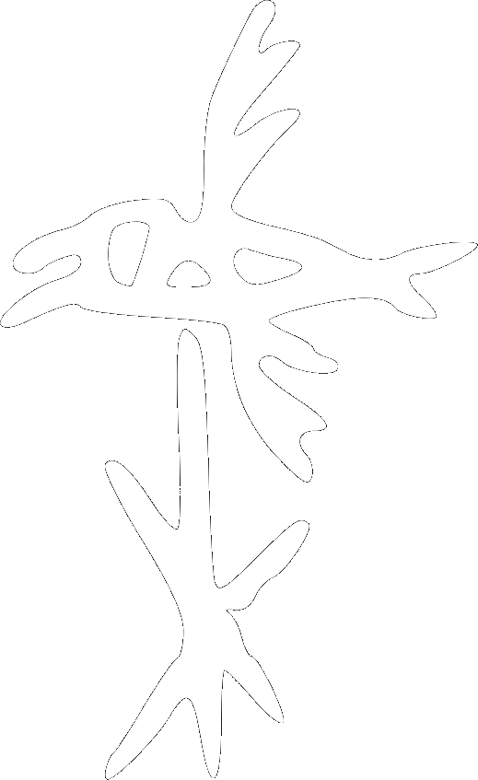
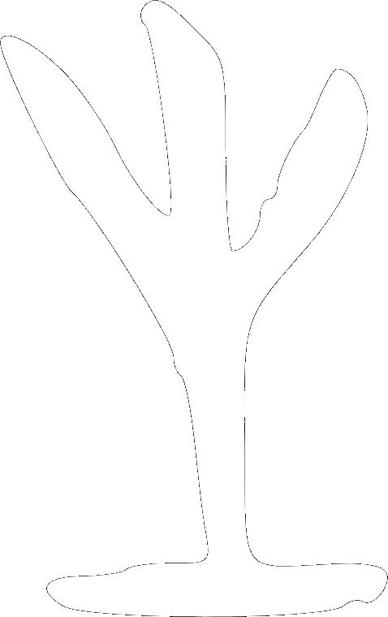
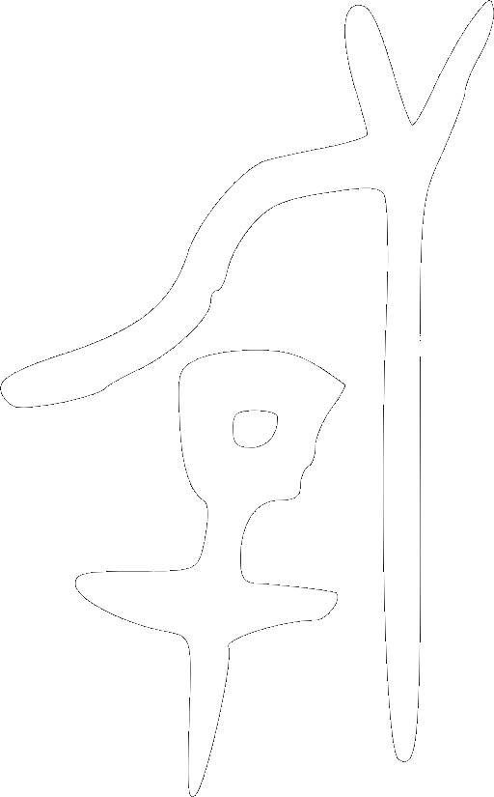

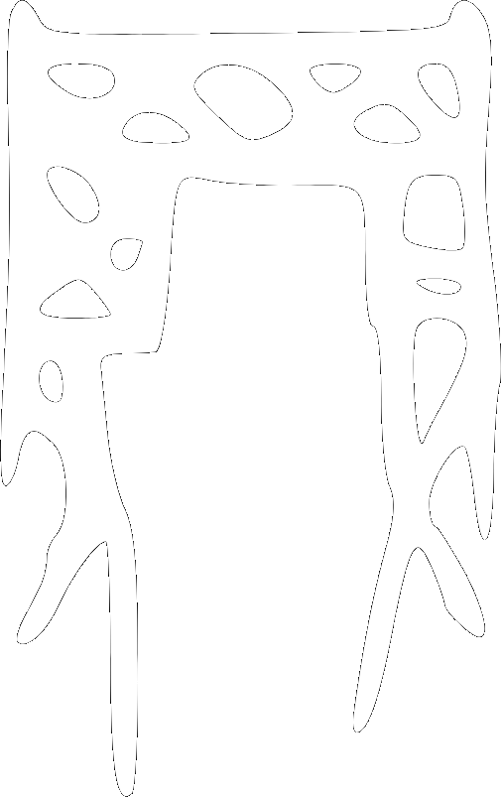
Method Outline
1
2
3
4
5
Dataset
CNN
(Classification)
GANs
(Generation)
Explore
GAN Zoo
Future
Extensions

Slide 8
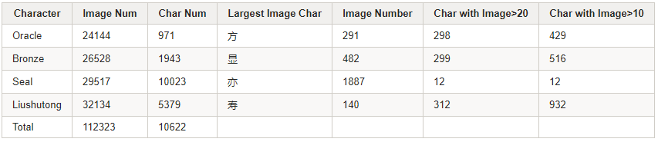
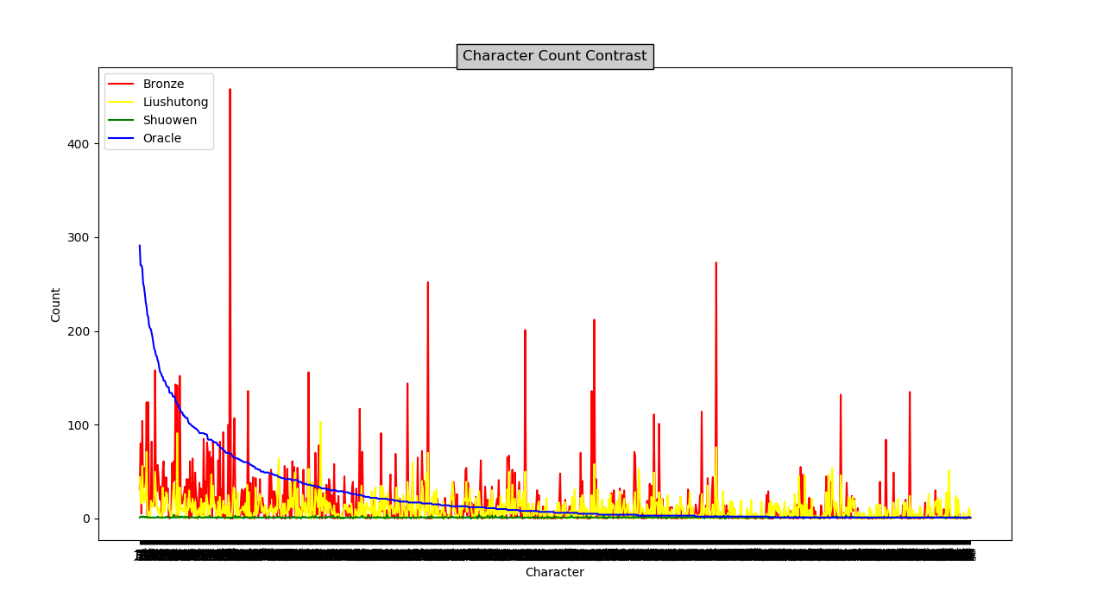
Dataset
Collection
2 web crawlers
4 types of scripts styles
300+ duplicate removals
110000+ images
…
Statistics of our dataset
Quantity comparison of four ancient scripts

Slide 9

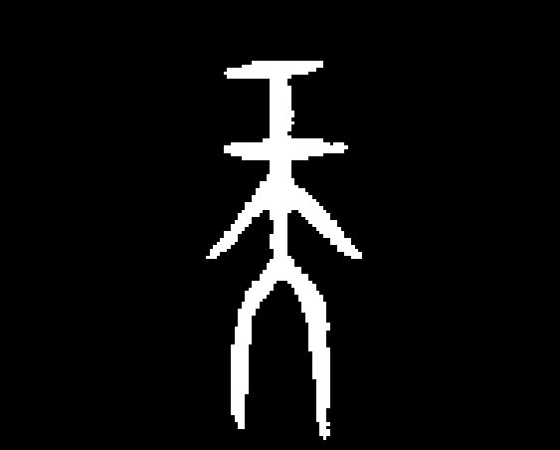







Dataset
Processing
An Original
Sample
Color
Negation
Trimming
&
Resampling
Border Adding
Original
Dataset

Slide 10


Convolutional Neural Networks
Input
Conv Layer
Fully Connected
Layer
Output
Classification
Method Outline
Change recognition to classification
Study features of Oracle bone scripts
0.98 → 林
0.02 → 王
0.23 → 任

Slide 11
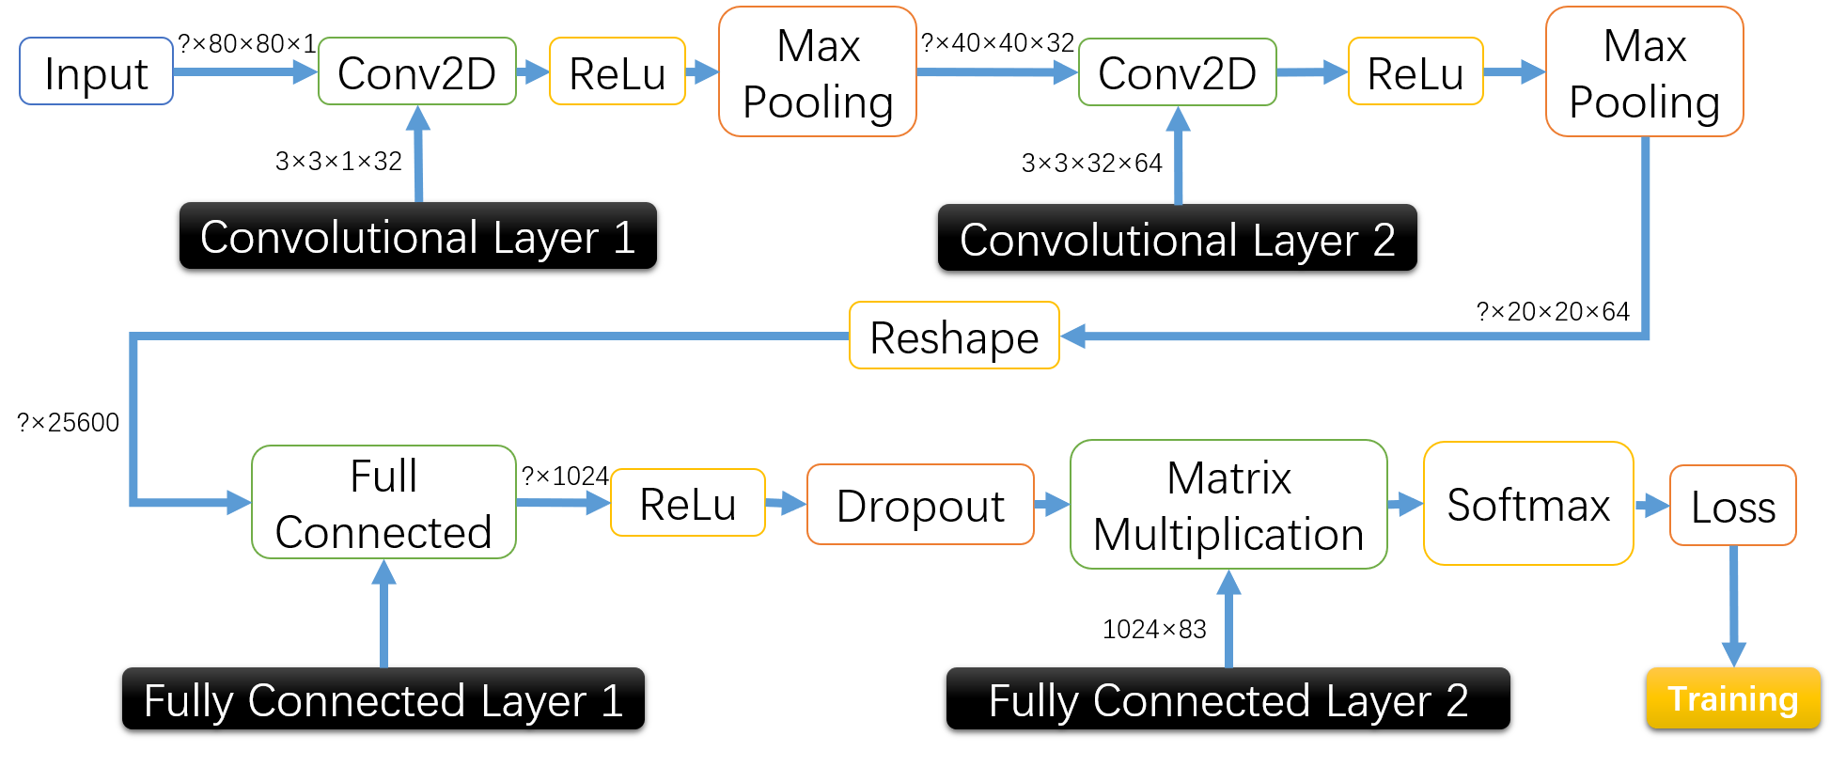
Convolutional Neural Networks
Structure
Structure of Base Line Implementation

Slide 12
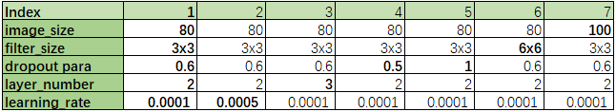
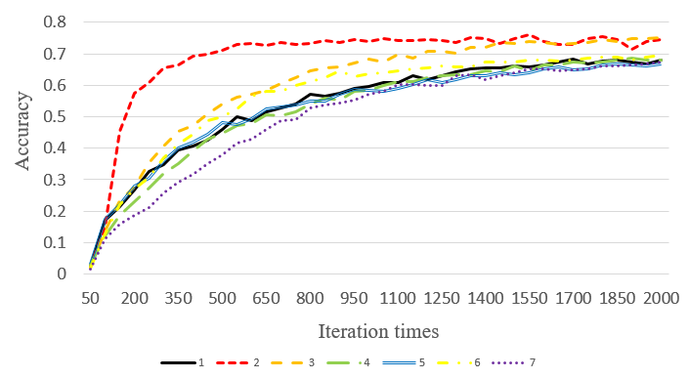
Convolutional Neural Networks
Result Analysis
Typical Parameter Table
High accuracy (>70%)
Influence of layer quantity
Influence of learning rate
Influence of dropout rate
Accuracy of Each Experiment

Slide 13

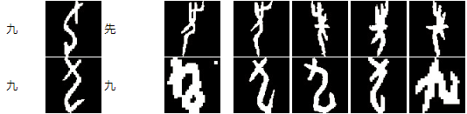

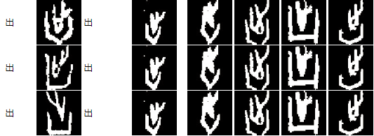
Convolutional Neural Networks
Target
Oracle
Prediction
Prediction’s Real Oracle
Result Analysis
Reasonable prediction
Not strong generalization ability
CNN Classification Results

Slide 14

Convolutional Neural Networks
Slow Training

Slide 15
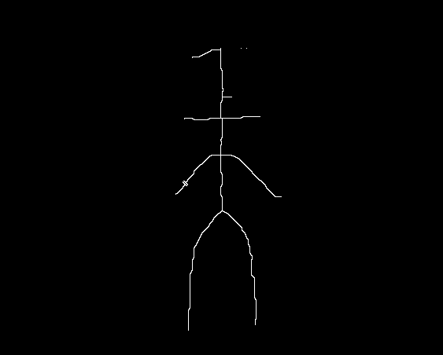
Convolutional Neural Networks
Thinning
Before
After

Slide 16
Generative Adversarial Networks
GAN Zoo
GAN used in specific situation
3D generation (3D-GAN, I-GAN, PrGAN, IWGAN, etc.)
physics (LAGAN, CaloGAN, etc.)
medical (AnoGAN, GAN-sep, Fila-GAN, medGAN, etc.)
face synthesis and recognition (GAN-VFS, TP-GAN, DR-GAN)
…
Other GAN variations
Wasserstein GAN, Softmax GAN, etc.
GAN with improvement
instability (Dualing GAN, Discrete GAN, EBGAN, DAN, etc.)
mode collapse (DRAGAN, Bayesian GAN, Unrolled GAN, etc.)
class label (ss-infoGAN, Dual-GAN, etc.)
expensive paired data (DiscoGAN, Cycle GAN, etc.)
…
GAN with combination
AE (Auto-encoding GAN, BEGAN, etc.)
VAE (VAE-GAN, IWGAN, CAVE-GAN, etc.)

Slide 17

Generative Adversarial Networks
Conditional GAN Method Outline
CGANs add boundaries to original GANs
Pix2Pix is an improved version of CGAN
Noise addition

Slide 18

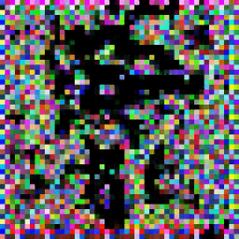

Generative Adversarial Networks
Conditional GAN Results
Oracle Bone Script
Fake Bronze Script
Target Bronze Script
Samples from 200 Epochs

Slide 19
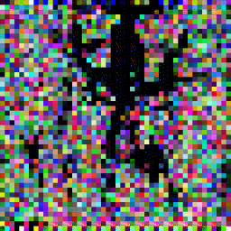
Generative Adversarial Networks
Conditional GAN Results
Oracle Bone Script
Fake Bronze Script
Target Bronze Script
Samples from 5000 Epochs

Slide 20

Generative Adversarial Networks
Conditional GAN Results
Oracle Bone Script
Fake Bronze Script
Target Bronze Script
Samples from 20000 Epochs

Slide 21
Generative Adversarial Networks
Samples without noise after 200/5000/20000 epochs

Slide 22
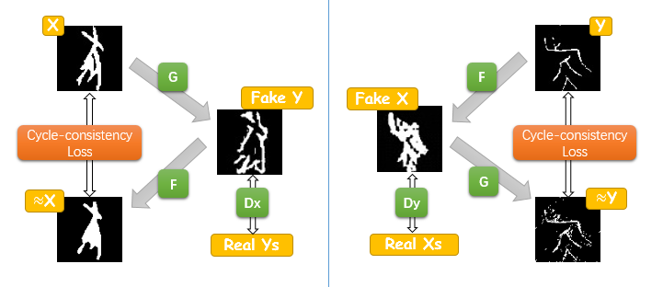
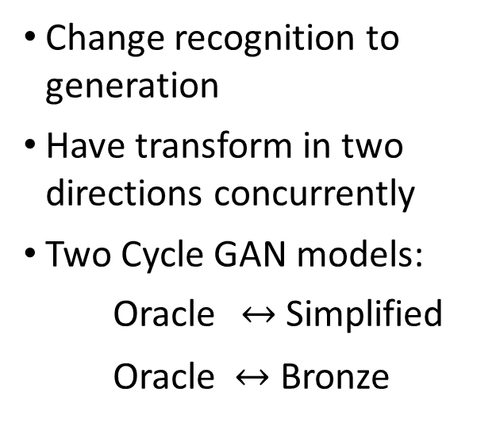
Generative Adversarial Networks
Cycle-Consistent GAN
Method Outline
Change recognition to generation
Have transform in two directions concurrently
Two Cycle GAN models:
Oracle $↔$ Simplified
Oracle $↔$ Bronze
Cycle GAN Structure

Slide 23
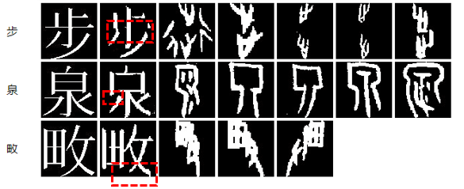
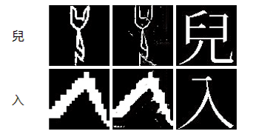


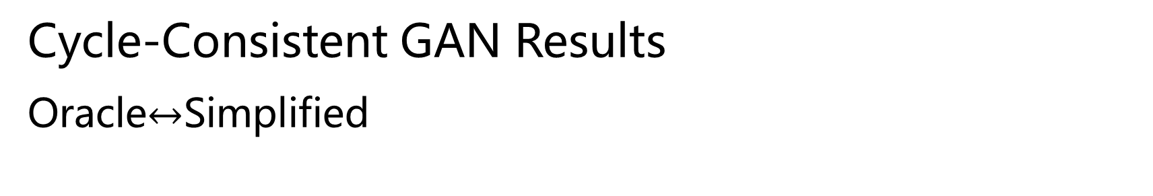
Generative Adversarial Networks
Cycle-Consistent GAN Results
Oracle$↔$Simplified
Simplified
Chinese
Fake Oracle
Target Oracle bone scripts
Oracle script
Fake simplified
Target simplified
Simplified Chinese Character$→$Oracle bone scripts
Oracle bone scripts$→$Simplified Chinese Character

Slide 24





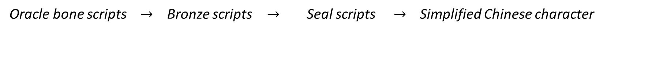
Generative Adversarial Networks
Cycle-Consistent GAN Result Analysis
Oracle bone scripts $→$ Simplified Chinese character
Oracle bone scripts $→$ Bronze scripts $→$ Seal scripts $→$ Simplified Chinese character

Slide 25
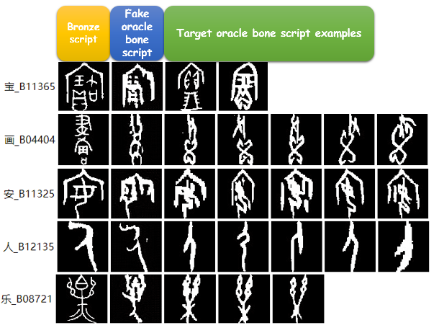

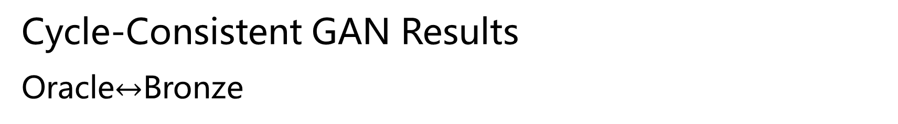
Generative Adversarial Networks
Cycle-Consistent GAN Results
Oracle$↔$Bronze
Bronze script
Fake Oracle
Target Bronze script examples
Bronze scripts$→$Oracle bone scripts

Slide 26
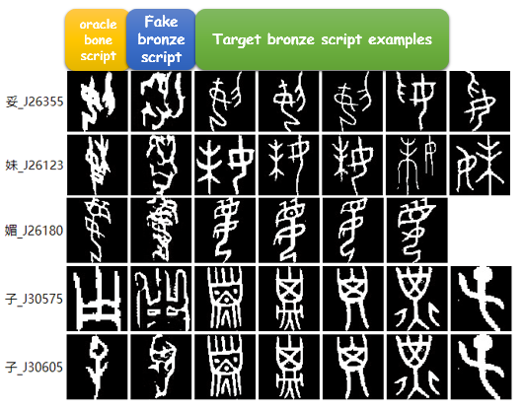

Generative Adversarial Networks
Cycle-Consistent GAN Results
Oracle$↔$Bronze
Oracle script
Fake
Bronze
Target Oracle script examples
Oracle bone scripts$→$Bronze scripts

Slide 27
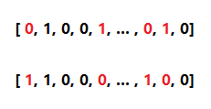
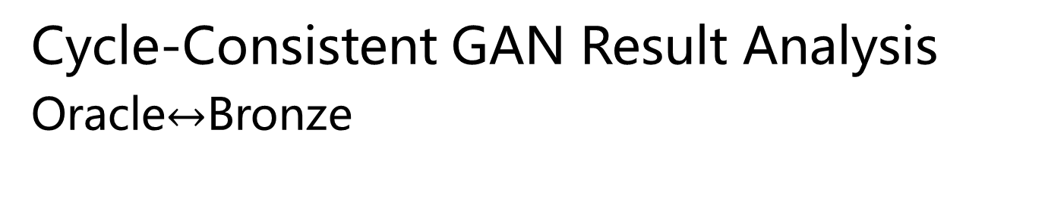
Generative Adversarial Networks
Cycle-Consistent GAN Result Analysis Oracle$↔$Bronze
Perceptual Hash Algorithm
calculate the hash values of faked pictures and real pictures
compare the hash values of faked pictures and real pictures
Result
the result equals to 0 → very similar
the result no bigger than 5 → similar
if the result bigger than 5 but no bigger than 10 → a little similar
if the result larger than 10 → different
hash value is a 64-bit length array
compare each values in the array and count the sum of the differences (the result is the sum)

Slide 28
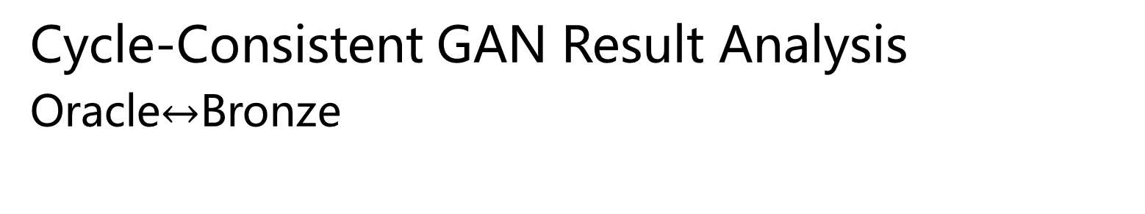
Generative Adversarial Networks
Cycle-Consistent GAN Result Analysis Oracle$↔$Bronze

Slide 29
叁
Challenges
What did we confront
PPT模板下载：www.1ppt.com/moban/ 行业PPT模板：www.1ppt.com/hangye/
节日PPT模板：www.1ppt.com/jieri/ PPT素材下载：www.1ppt.com/sucai/
PPT背景图片：www.1ppt.com/beijing/ PPT图表下载：www.1ppt.com/tubiao/
优秀PPT下载：www.1ppt.com/xiazai/ PPT教程： www.1ppt.com/powerpoint/
Word教程： www.1ppt.com/word/ Excel教程：www.1ppt.com/excel/
资料下载：www.1ppt.com/ziliao/ PPT课件下载：www.1ppt.com/kejian/
范文下载：www.1ppt.com/fanwen/ 试卷下载：www.1ppt.com/shiti/
教案下载：www.1ppt.com/jiaoan/ PPT论坛：www.1ppt.cn

Slide 30
Challenges
1. Start from scratch
2. The performance of a dataset varies a lot in different models
Dataset Type | CNN | Cycle GAN | CGAN
Monochrome Dataset | Slow | Good | Awful
Noise appended Dataset | Slow | NA | Good
Thinning Dataset | Good | Awful | Awful
3. Choose methods suitable for the tasks
More than 400 GANs
4. Require through understanding of mathematical derivations and structure transform before changing anything in a network.

Slide 31
肆
Extensions
What we will do
PPT模板下载：www.1ppt.com/moban/ 行业PPT模板：www.1ppt.com/hangye/
节日PPT模板：www.1ppt.com/jieri/ PPT素材下载：www.1ppt.com/sucai/
PPT背景图片：www.1ppt.com/beijing/ PPT图表下载：www.1ppt.com/tubiao/
优秀PPT下载：www.1ppt.com/xiazai/ PPT教程： www.1ppt.com/powerpoint/
Word教程： www.1ppt.com/word/ Excel教程：www.1ppt.com/excel/
资料下载：www.1ppt.com/ziliao/ PPT课件下载：www.1ppt.com/kejian/
范文下载：www.1ppt.com/fanwen/ 试卷下载：www.1ppt.com/shiti/
教案下载：www.1ppt.com/jiaoan/ PPT论坛：www.1ppt.cn

Slide 32
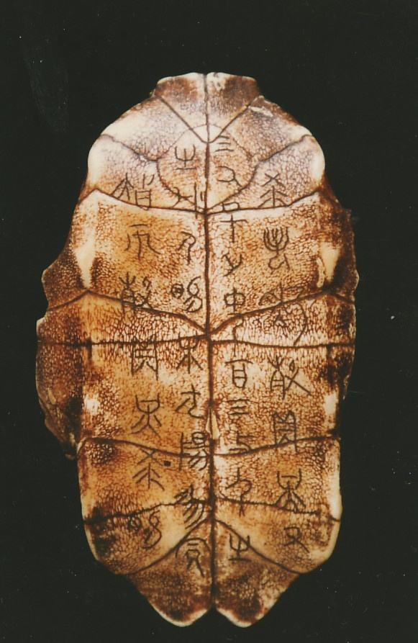
Extensions
Retrieve origin data from the scanning pictures of animal bones
Different models for transformation of different type
More possible models

Slide 33

If you like our presentation, do not hesitate your thumb up and watch our project on GitHub. (https://github.com/Ancient-Discovery/Colosseum).
(An oracle bone script character that literally means “thumb up”.)

Slide 34
Thanks for Listening

